Slide 1
Computer Networks
CS 430

Slide 2
Exam 2 Review

Slide 3
Exam Format
10 questions
Short answers
Short problems
Closed book

Slide 4
Topics
IPv4
IPv6
Subnetting
ICMP
Forwarding
Link state vs Distance vector
Intra-AS vs Inter-AS
Throughput
TCP
DNS
Binary operations

Slide 5
Internet Layer

Slide 6
IPv4

Slide 7
IPv6

Slide 8
ICMP

Slide 9
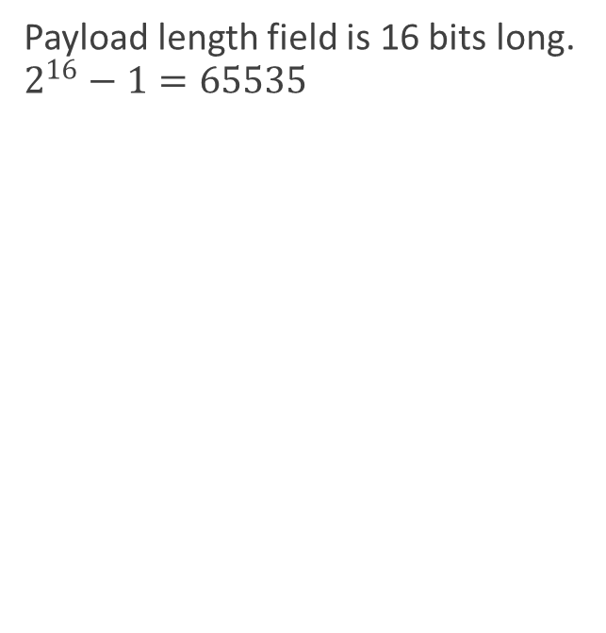
Internet
Why the maximum size of an IP packet is 64 KB?
Payload length field is 16 bits long. $2^{16}−1=65535$

Slide 10
Internet
What can you say about an IP datagram if the value of the first byte of its header is 0x44? Why isn’t it a valid IPv4 or IPv6 datagram?
It’s invalid IPv4 datagram. Header cannot be smaller than 5 x 4 bytes.
It’s invalid IPv6 datagram. The first value should be 6.

Slide 11
Internet
Why can’t a receiving host send an error message to a sender in case of an IP checksum error?
Checksum means some bits were altered, but the receiver cannot know which bits exactly.

Slide 12
ICMP
Why ICMP error messages are not sent if an ICMP message is lost?
That would add a burden to a network, already susceptible to errors and congestion.

Slide 13

IPv6
Imagine a block of 1 billion (1 billion = 10⁹) IPv6 addresses allocated every picosecond. How many years (1 year = 365 days) will pass until IPv6 address space is depleted?
$\frac{{10}^{38.5}}{\frac{{10}^{9}}{{10}^{−12}}}={10}^{17.5}sec=>\frac{{10}^{17.5}}{{10}^{7.5}}=$
${10}^{10}=10 billion years$

Slide 14
IPv6
IPv6 address | Valid or not | Why not?
FF0C::B1
2001:310:AB12:67:FFFFF:0:1523:1
2a03:2880:10:8f01:face:b00c:0:25
2607:f8b0:4009:802:1004

Slide 15
IPv6
IPv6 address | Valid or not | Why not?
FF0C::B1 | Valid
2001:310:AB12:67:FFFFF:0:1523:1 | Invalid | FFFFF
2a03:2880:10:8f01:face:b00c:0:25 | Valid
2607:f8b0:4009:802:1004 | Invalid | Too short

Slide 16
Subnetting (192.168.43.0/24)
Department | Requested size | Allocated hosts | Subnet Address | Mask
Accounting | 25
Marketing | 35
Human Resources | 30
Shipping | 10
IT | 15

Slide 17
Subnetting (192.168.43.0/24)
Department | Requested
Accounting | 25
Marketing | 35
Human Resources | 30
Shipping | 10
IT | 15
(256)
(128)
(128)
MRKT (64)
(64)
ACCT (32)
HUMN (32)
(64)
(64)
IT (32)
(32)
SHPP (16)
(16)

Slide 18
Subnetting (192.168.43.0/24)
/24
/25
/25
MRKT /26
/26
ACCT /27
HUMN /27
/26
/26
IT /27
/27
SHPP /28
/28
(256)
(128)
(128)
MRKT (64)
(64)
ACCT (32)
HUMN (32)
(64)
(64)
IT (32)
(32)
SHPP (16)
(16)

Slide 19
Subnetting (192.168.43.0/24)
Department | Requested size | Allocated hosts | Subnet Address | Mask
Accounting | 25
Marketing | 35 | 62 | 192.168.43.0 | /26
Human Resources | 30
Shipping | 10
IT | 15

Slide 20
Subnetting (192.168.43.0/24)
Department | Requested size | Allocated hosts | Subnet Address | Mask
Accounting | 25 | 30 | 192.168.43.64 | /27
Marketing | 35 | 62 | 192.168.43.0 | /26
Human Resources | 30
Shipping | 10
IT | 15

Slide 21
Subnetting (192.168.43.0/24)
Department | Requested size | Allocated hosts | Subnet Address | Mask
Accounting | 25 | 30 | 192.168.43.64 | /27
Marketing | 35 | 62 | 192.168.43.0 | /26
Human Resources | 30 | 30 | 192.168.43.96 | /27
Shipping | 10
IT | 15

Slide 22
Subnetting (192.168.43.0/24)
Department | Requested size | Allocated hosts | Subnet Address | Mask
Accounting | 25 | 30 | 192.168.43.64 | /27
Marketing | 35 | 62 | 192.168.43.0 | /26
Human Resources | 30 | 30 | 192.168.43.96 | /27
Shipping | 10
IT | 15 | 30 | 192.168.43.128 | /27

Slide 23
Subnetting (192.168.43.0/24)
Department | Requested size | Allocated hosts | Subnet Address | Mask
Accounting | 25 | 30 | 192.168.43.64 | /27
Marketing | 35 | 62 | 192.168.43.0 | /26
Human Resources | 30 | 30 | 192.168.43.96 | /27
Shipping | 10 | 14 | 192.168.43.160 | /28
IT | 15 | 30 | 192.168.43.128 | /27

Slide 24
Subnetting
Subnet ID | Subnet Mask | Mask Bits | Host Addresses | Broadcast Address
10.0.0.0 | 255.255.240.0 | /20 | ⁽¹⁾ | ⁽²⁾
⁽³⁾ | 255.255.255.252 | ⁽⁴⁾ | 2 | 3.1.0.3
172.16.0.0 | ⁽⁵⁾ | /25 | ⁽⁶⁾ | 172.16.0.127
⁽⁷⁾ | 255.255.255.240 | ⁽⁸⁾ | 14 | 191.168.100.15
130.210.3.0 | ⁽⁹⁾ | /22 | 1022 | ⁽¹⁰⁾

Slide 25
Subnetting
Subnet ID | Subnet Mask | Mask Bits | Host Addresses | Broadcast Address
10.0.0.0 | 255.255.240.0 | /20 | 4094 | 10.0.15.255
3.1.0.0 | 255.255.255.252 | /30 | 2 | 3.1.0.3
172.16.0.0 | 255.255.255.128 | /25 | 126 | 172.16.0.127
191.168.100.0 | 255.255.255.240 | /28 | 14 | 191.168.100.15
130.210.0.0 | 255.255.252.0 | /22 | 1022 | 130.210.3.255

Slide 26
Subnetting (4.3.0.0/22)
Department | Requested | Received | Mask
CS | 200 | 254 | /24
Math | 50 | 62 | /26
Business | 100 | 126 | /25
Physics | 20 | 30 | /27
Music | 300 | 510 | /23

Slide 27
Subnetting (4.3.0.0/22)
/22
MUS
/23
CS
/24
BUS
/25
MATH
/26
PHY
/27

Slide 28
Subnetting (4.3.0.0/22)
Dept | Request | Hosts | Mask | Subnet | Broadcast
CS | 200 | 254 | /24 | 4.3.2.0 | 4.3.2.255
Math | 50 | 62 | /26 | 4.3.3.128 | 4.3.3.191
Business | 100 | 126 | /25 | 4.3.3.0 | 4.3.3.127
Physics | 20 | 30 | /27 | 4.3.3.192 | 4.3.3.223
Music | 300 | 510 | /23 | 4.3.0.0 | 4.3.1.255

Slide 29
Subnetting (4.3.0.0/22)
/22
/23
MUS
/24
/25
BUS
/26
MATH
/27
PHY
CS

Slide 30
Subnetting (4.3.0.0/22)
Dept | Request | Hosts | Mask | Subnet | Broadcast
CS | 200 | 254 | /24 | 4.3.1.0 | 4.3.1.255
Math | 50 | 62 | /26 | 4.3.0.64 | 4.3.0.127
Business | 100 | 126 | /25 | 4.3.0.128 | 4.3.0.255
Physics | 20 | 30 | /27 | 4.3.0.32 | 4.3.0.63
Music | 300 | 510 | /23 | 4.3.2.0 | 4.3.3.255

Slide 31
Routing

Slide 32
Routing

Slide 33
Routing
Description | Protocol
EGP designed to exchange routing and reachability information between AS
A distance-vector routing protocol, which employs the hop count as a routing metric
A link-state routing protocol for Internet Protocol (IP) networks
An advanced distance-vector routing protocol designed by Cisco Systems

Slide 34
Routing
Description | Protocol
EGP designed to exchange routing and reachability information between AS | BGP
A distance-vector routing protocol, which employs the hop count as a routing metric | RIP
A link-state routing protocol for Internet Protocol (IP) networks | OSPF, IS-IS
An advanced distance-vector routing protocol designed by Cisco Systems | EIGRP

Slide 35
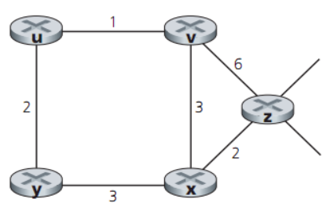
Distance Vector Routing

Slide 36
Ethernet

Slide 37
ASCII Table

Slide 38
Thank You!

